Slide 1



Customer Shopping Behavior Analysis
A comprehensive guide for Intermediate
xys
sumit
September 20, 2026
Made with SlideMaker.app

Slide 2




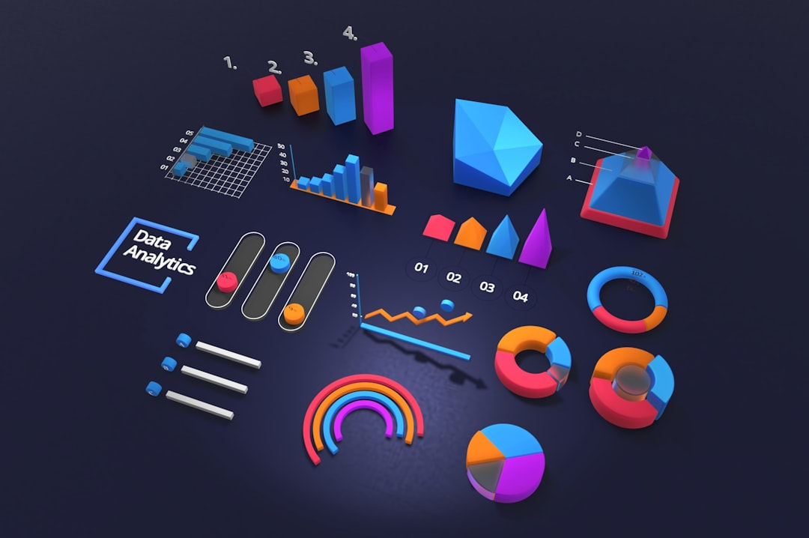

Customer Shopping Behavior Analysis
This presentation delves into an in-depth analysis of customer shopping behavior derived from 3,900 transactions across diverse product categories. By examining spending patterns, customer segments, and product preferences, we aim to provide actionable insights that can inform strategic business decisions. Our findings will guide marketing strategies and enhance customer engagement through targeted initiatives.
Made with SlideMaker.app

Slide 3

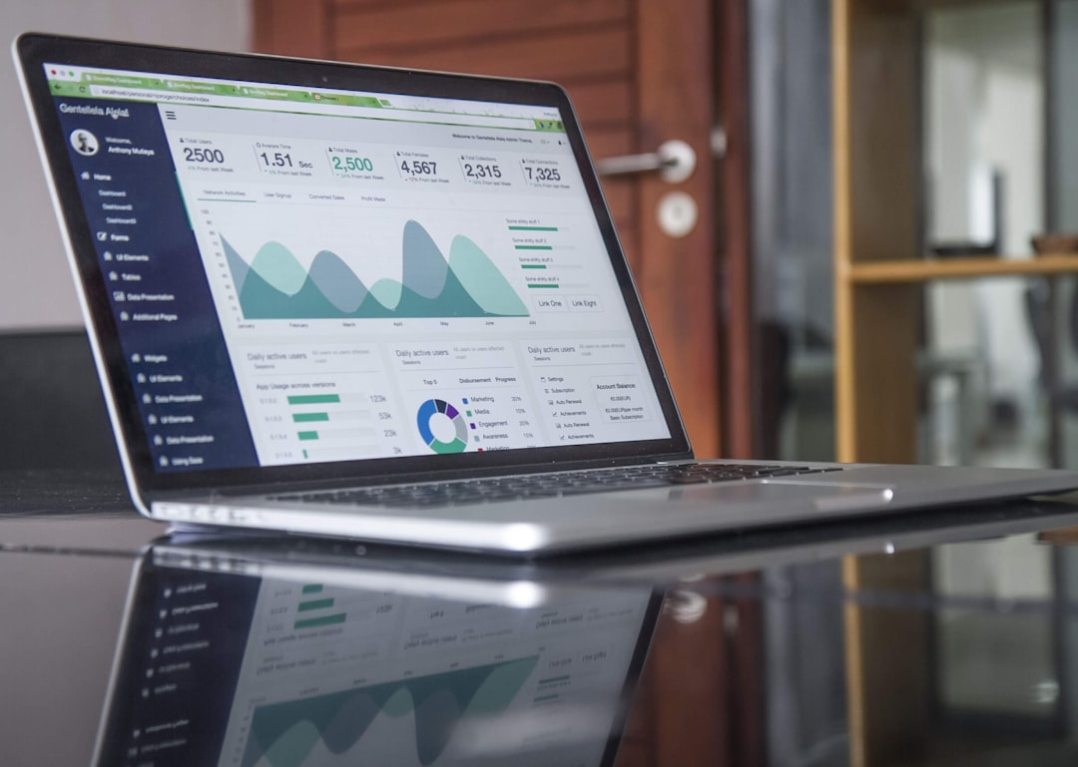
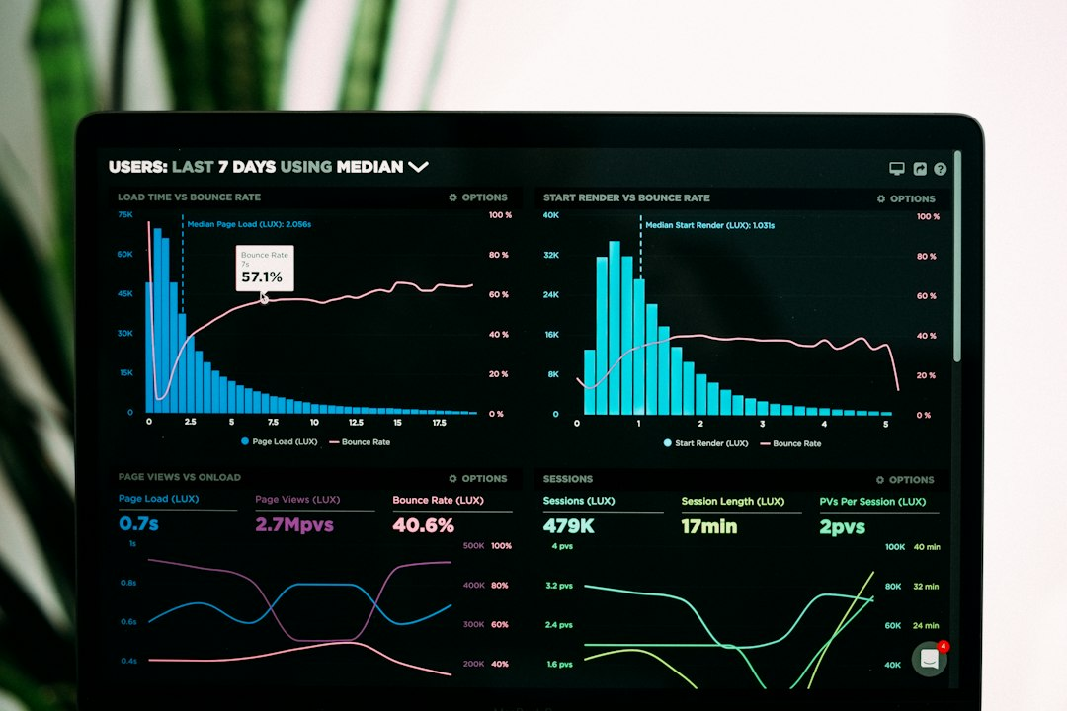



Project Overview
01
Analyzed 3900 Purchases
Examined 3900 transactions across diverse product categories for insights.
02
Insights into Spending Patterns
Uncovered spending behaviors to inform strategic business decisions.
03
Understanding Customer Segments
Identified key customer segments to enhance targeted marketing efforts.
Made with SlideMaker.app

Slide 4
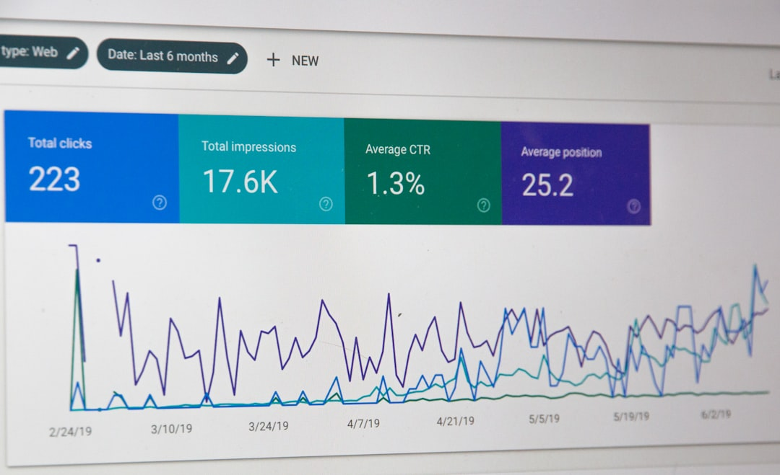
Dataset Summary
Contains 3900 rows and 18 columns
Key features include customer demographics and
Contains 3900 rows and 18 columns of transactional data.
Key features include customer demographics and purchase details.
Identified 37 missing values in the
Focuses on various shopping behavior metrics
Identified 37 missing values in the review rating column.
Focuses on various shopping behavior metrics.
Made with SlideMaker.app
Photo by Stephen Phillips - Hostreviews.co.uk

Slide 5
How to Prepare and Clean Data for Analysis
1
Import Necessary Libraries
Begin by importing essential Python libraries such as Numpy and Pandas to facilitate data manipulation and analysis.
2
Load the Dataset
Use Pandas to load the transactional data into a DataFrame for further exploration and analysis.
3
Initial Data Checks
Perform initial checks on the DataFrame using df.info() to understand the structure and df.describe() for summary statistics.
4
Handle Missing Data
Identify and handle missing values in the dataset, particularly in the Review Rating column, by applying appropriate imputation techniques.
5
Standardize Column Names
Rename columns to a consistent snake_case format to enhance readability and maintainability of the dataset.
6
Create New Features
Generate new features such as 'age_group' by binning customer ages and 'purchase_frequency_days' based on purchase history to enrich the dataset.
Made with SlideMaker.app

Slide 6
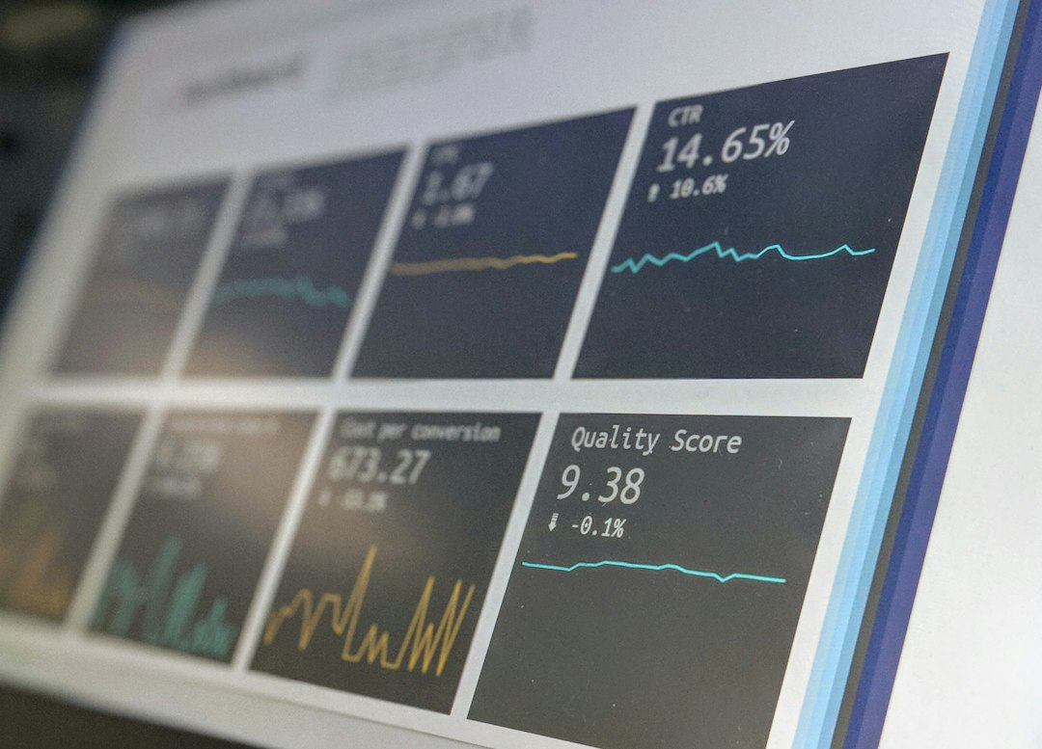
Data Analysis Using SQL
Revenue by Gender Analysis
01
Total revenue was compared between male and female customers using SQL queries.
High Spending Discount Users
02
Identified customers who spent above average despite using discounts.
Customer Segmentation
03
Classified customers into new, returning, and loyal based on purchase history.
Made with SlideMaker.app

Slide 7
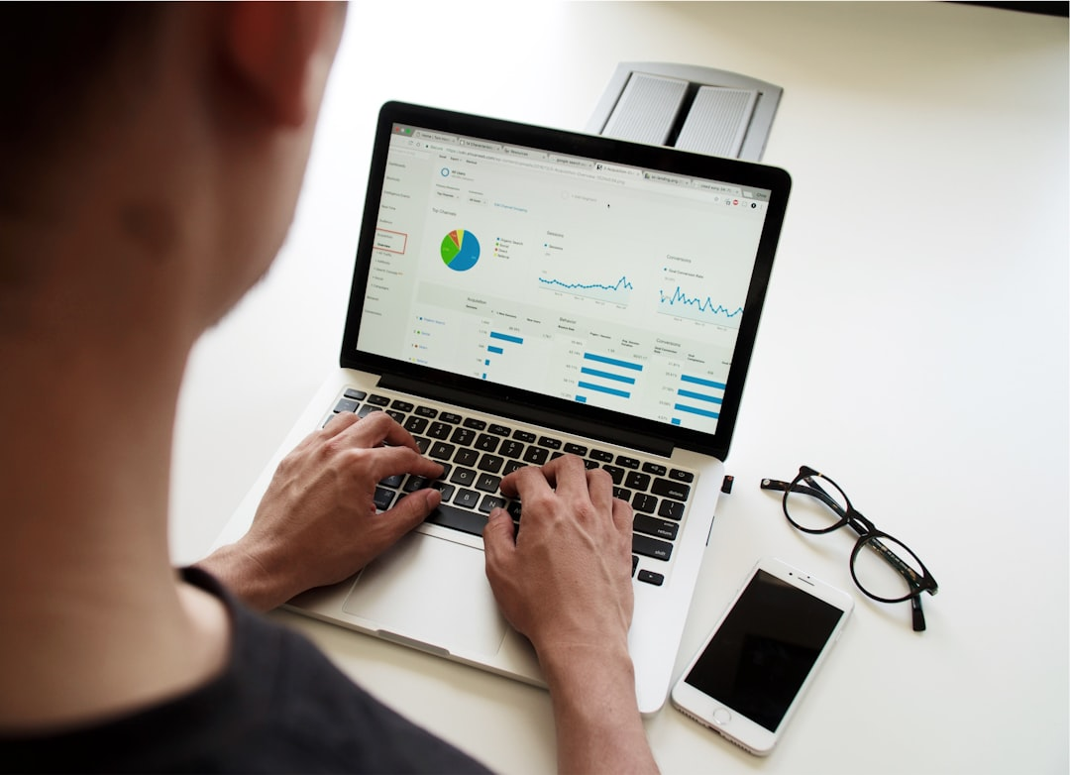
Key Findings
Bar chart showing revenue by gender
Top 5 products by average rating
Top 5 products by average rating displayed.
Bar chart showing revenue by gender.
Revenue comparisons between subscribers and non-subscribers
Customer segmentation breakdown visualization
Revenue comparisons between subscribers and non-subscribers.
Customer segmentation breakdown visualization.
Made with SlideMaker.app
Photo by Campaign Creators

Slide 8
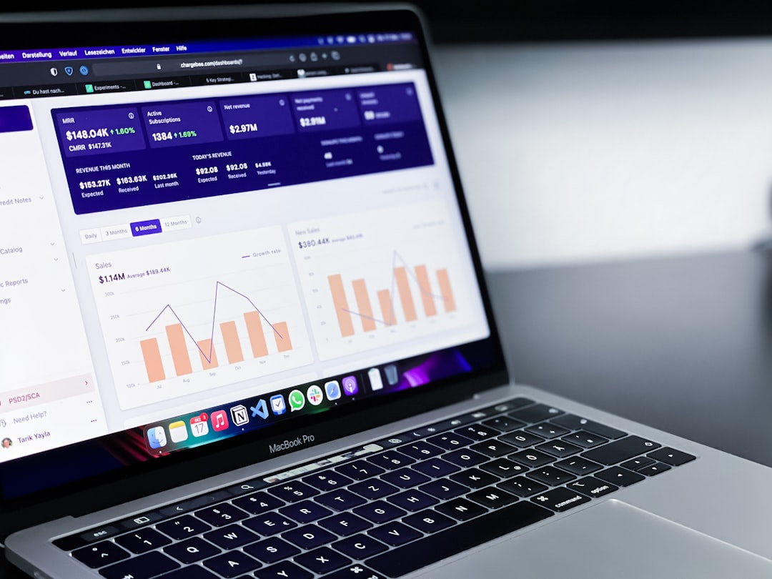
Business Recommendations
Boost Subscription Benefits
Promote exclusive benefits to increase subscriber engagement and retention.
Implement Loyalty Programs
Reward repeat buyers to enhance customer loyalty and increase sales.
Review Discount Policies
Adjust discount strategies to balance sales growth with profit margins.
Targeted Marketing Efforts
Focus marketing on high-revenue age groups to maximize ROI.
Photo by path digital
Made with SlideMaker.app

Slide 9


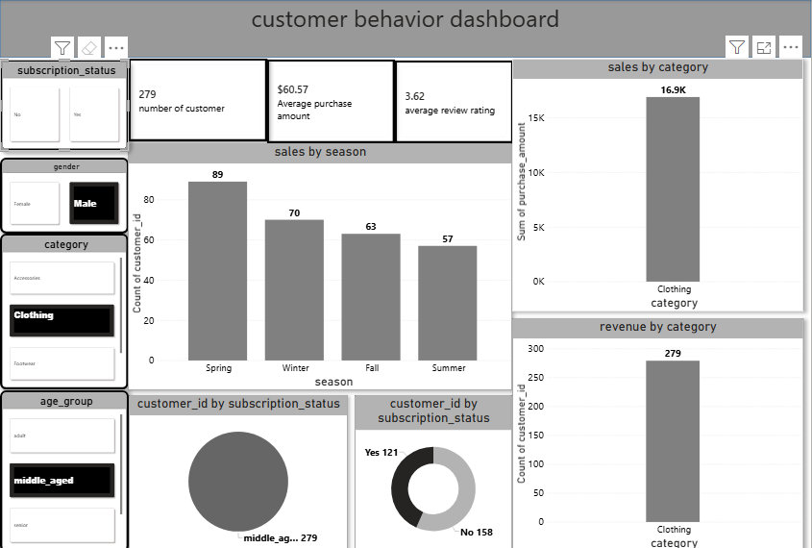

Customer Behavior Dashboard Overview
This dashboard visualizes key metrics: sales by season, category revenue, and customer counts by subscription status. It highlights trends and customer preferences, aiding strategic decisions. The bar charts provide a clear comparison of performance across different dimensions, essential for understanding customer behavior.
Made with SlideMaker.app

Slide 10
How to Implement Business Recommendations Effectively
1
Analyze Current Subscription Benefits
Review existing subscription offerings to identify strengths and weaknesses. Adjust benefits based on customer feedback and competitive analysis to enhance value.
2
Develop a Loyalty Program Framework
Create a structured loyalty program that rewards repeat buyers. Define tiers based on purchase frequency and offer incentives that encourage customers to reach higher tiers.
3
Review and Adjust Discount Policies
Analyze the impact of current discount strategies on sales and margins. Adjust policies to ensure they drive sales without compromising profitability.
4
Focus Marketing Strategies on Key Segments
Utilize data insights to tailor marketing efforts towards high-revenue customer segments. Develop targeted campaigns that resonate with identified demographics.
Made with SlideMaker.app

Slide 11






Key Takeaways
This analysis reveals critical insights into customer shopping behavior, highlighting the importance of targeted marketing and product positioning. By focusing on high-revenue age groups and promoting subscription benefits, businesses can enhance customer loyalty and drive revenue growth. Implementing these strategies will not only improve customer engagement but also position the brand for future success in a competitive market.
Made with SlideMaker.app

